Slide 1
Retail Sales Intelligence: A Comparative Dashboard Analysis of Zara and Nike
Azmath

Slide 2



Zara & Nike Sales Dashboard Overview
This presentation combines visual insights from Zara and Nike datasets.
Zara data focuses on pricing, product positioning, and promotions.
Nike data includes product categories, regional sales, and sales channels.
Dashboards created in Tableau using real-world sales data.
Key trends and strategic recommendations are drawn for both brands.

Slide 3
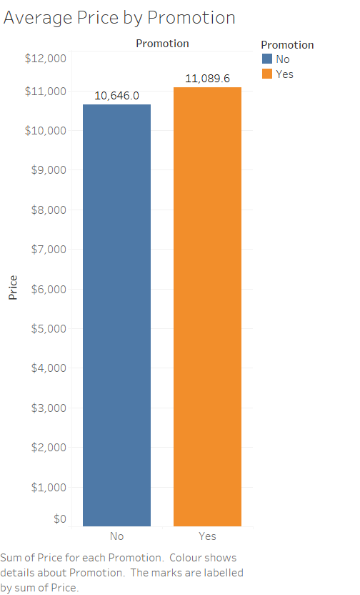
Zara – Average Price by Promotion
Promoted products had a slightly higher average price ($11,089.6).
Non-promoted items averaged $10,646.0, suggesting a premium strategy.
Promotions may target higher-end or seasonal stock rather than discounts.
Contrary to expectations, promotions did not decrease average price.
Reflects brand positioning that values exclusivity and timing.

Slide 4
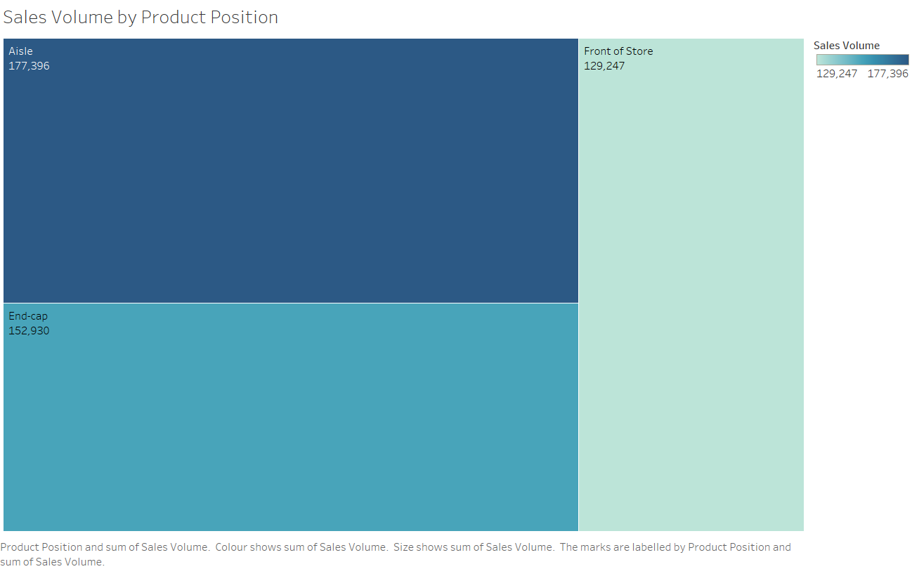
Zara – Sales by Section and Position
MAN section vastly outperformed WOMAN in sales volume.
Highest product visibility (Aisle/End-cap) correlates with higher volume.
WOMAN section had lower sales, indicating growth potential.
Product placement directly impacts shopper behavior and conversion.
Store layout strategy should focus on high-traffic visibility zones.

Slide 5
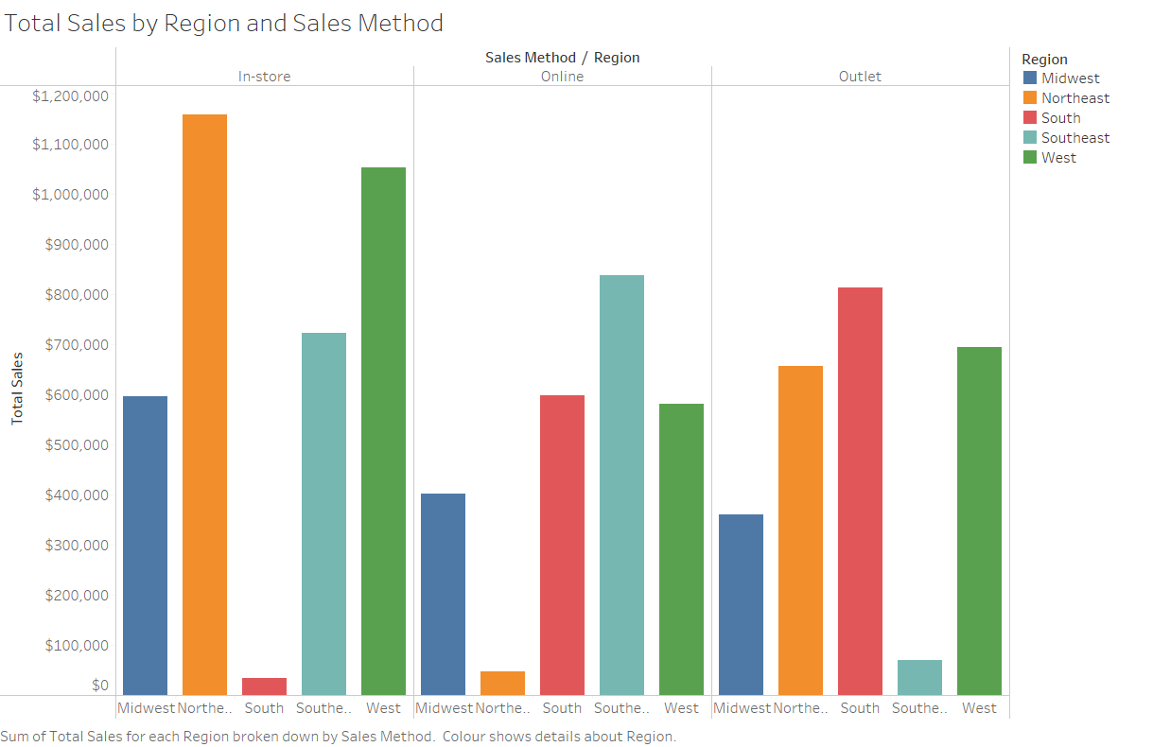
Nike – Sales by Region and Method
In-store sales dominate in Northeast, exceeding $1.1 million.
Southeast and South regions show strong online performance.
Outlet stores perform well in South and West.
Regional channel optimization is key to Nike’s retail strategy.
Balanced sales mix across U.S. enables targeted channel strategies.

Slide 6
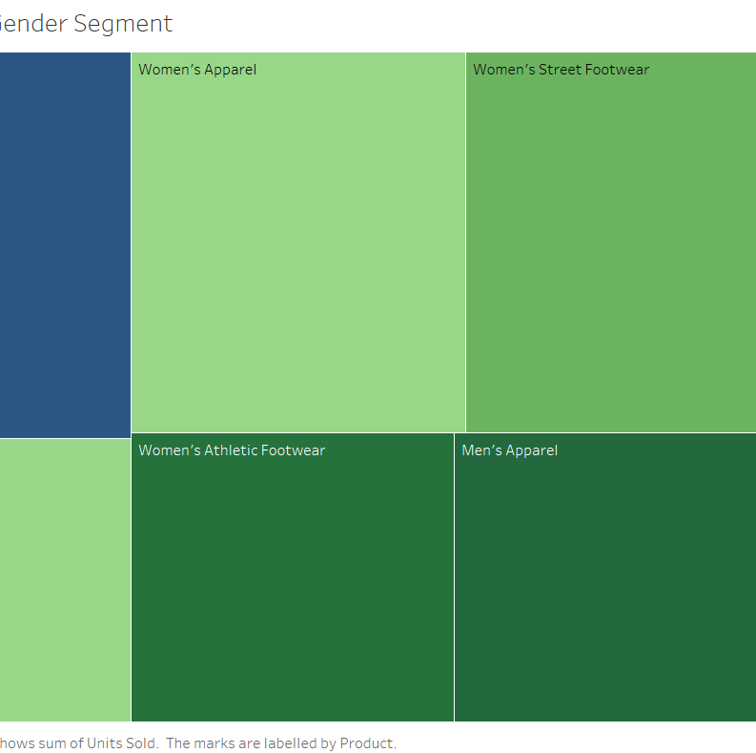
Nike – Product-wise Units Sold
Men’s Street Footwear leads all categories in units sold.
Women’s Apparel and Street Footwear perform better than Athletic.
Men’s products consistently outsell women’s across categories.
Women’s Athletic Footwear shows the lowest sales and growth potential.
Indicates a need for more focused marketing in women’s sportswear.

Slide 7
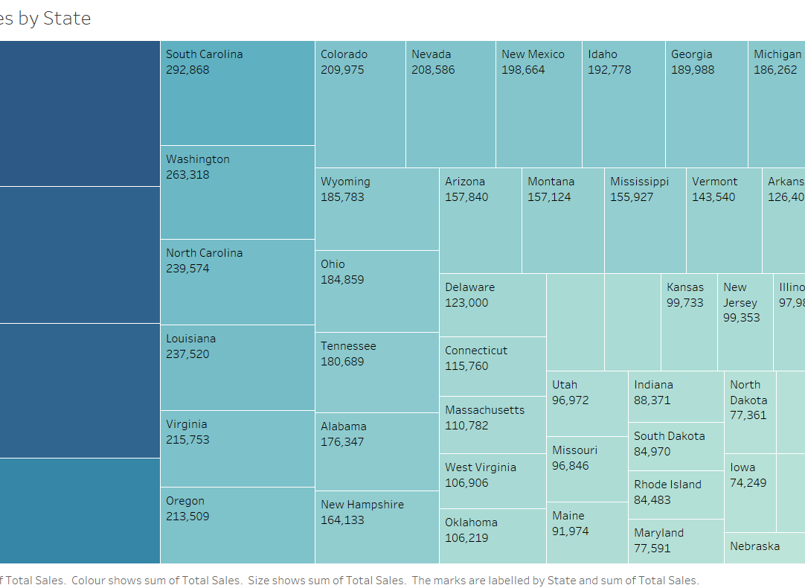
Nike – Total Sales by State
New York ($642K), California, and Florida lead in total sales.
Urban and coastal regions dominate Nike’s state performance.
Midwest and interior states underperform comparatively.
Sales patterns suggest targeting high-density population centers.
Geo-based sales strategies can optimize reach and allocation.

Slide 8
Cross-Brand Insights
Zara’s menswear and end-cap placement drive higher volume.
Nike’s strength lies in men's streetwear and in-store performance.
Both brands benefit from channel and regional segmentation.
Promotion use differs: Zara elevates price, Nike drives volume.
Gender-specific gaps present growth opportunities for both.

Slide 9
Strategic Recommendations
Zara: Expand WOMAN category through fashion-forward marketing.
1
Zara: Prioritize best-selling placements like front of store and end-cap.
2
Nike: Grow digital presence in South and Southeast U.S.
3
Nike: Reallocate stock based on high-sales states like NY and CA.
4
Both: Use insights dashboards for ongoing performance optimization.
5

Slide 10

Conclusion
Visual dashboards reveal clear product, region, and channel insights.
Both brands show opportunities to improve underperforming segments.
Zara's physical layout and promotions are key revenue drivers.
Nike’s performance varies strongly by region and product type.
Strategic focus based on data leads to smarter, faster decisions.

Slide 11
Next Steps
Continue data collection with seasonal, competitor, and customer metrics.
Incorporate time-series data to track performance trends.
Expand dashboards for executive and departmental reporting.
Develop KPIs around growth goals, gender segmentation, and ROI.
Maintain regular visualization updates to monitor market shifts.

